Slide 1


2015 – 2030
India Polypropylene (Comprehensive Techno-Commercial Market Analysis and Forecast)
MARKET INTELLIGENCE . CONSULTING

Slide 2
Table of Contents
S. No. | Contents |  |  | Page No
1. | Product & Technology Overview |  |  | 4
2. | India Polypropylene Homopolymer Outlook, 2015-2030F |  |  | 6
 | 2.1. | Capacity, By Volume
 |  | 2.1.1. | By Company | 7
 |  | 2.1.2. | By Location | 8
 |  | 2.1.3. | By Technology | 9
 | 2.2. | Production
 |  | 2.2.1. | By Company | 10
 | 2.3. | Operating Efficiency
 |  | 2.3.1. | By Company | 11
3. | India Polypropylene Homopolymer Demand-Supply Scenario, 2015-2030F, By Volume |  |  | 13
 | 3.1. | Demand
 | 3.2. | Supply
 | 3.3. | Gap
 | 3.4. | Inventory
4. | India Polypropylene Homopolymer Demand Outlook, 2015-2030F, By Volume |  |  | 15
 | 4.1. | By Derivative |  | 16
 | 4.3. | By Sales Channel |  | 17
 | 4.4. | By Region |  | 18
 | 4.5. | By Company |  | 19

Slide 3
Table of Contents
S. No. | Contents |  |  | Page No
5. | Pricing Analysis (Historical and Forecast) |  |  | 20
 | 5.1. | Weekly | Weekly
 | 5.2. | Monthly (Historical & Forecast) | Monthly (Historical & Forecast)
 | 5.3. | Yearly (Historical & Forecast) | Yearly (Historical & Forecast)
6. | Trade Dynamics, 2015-2021 |  |  | 25
 | 6.1. | Top Exporting Countries (Value & Volume) | Top Exporting Countries (Value & Volume)
 | 6.2. | Top Importing Countries (Value & Volume) | Top Importing Countries (Value & Volume)
7. | List of Major Consumers |  |  | 28
 | 7.1. | Location-Wise Monthly Consumption | Location-Wise Monthly Consumption
8. | Competitive Landscape
 | 8.1. | Company Profiles (Basic Details, Financials, Segmental/Product Information, Expansion Plans, SWOT Analysis and Key Strategies) | Company Profiles
 |  | 8.1.1. | Reliance Industries Ltd | 32
 |  | 8.1.2. | Indian Oil Corporation Limited | 34
 |  | 8.1.3. | Bharat Petroleum Corporation Limited | 36
 |  | 8.1.4. | ONGC Mangalore Petrochemicals Limited | 38
 |  | 8.1.5. | Exxon Mobil Corporation | 40
9. | Policy & Regulatory Landscape |  |  | 42
10. | Strategic Recommendations |  |  | 44
 | 10.1. | Key Focus Area & Recommendation | Key Focus Area & Recommendation
11. | About Us & Disclaimer |  |  | 46

Slide 4
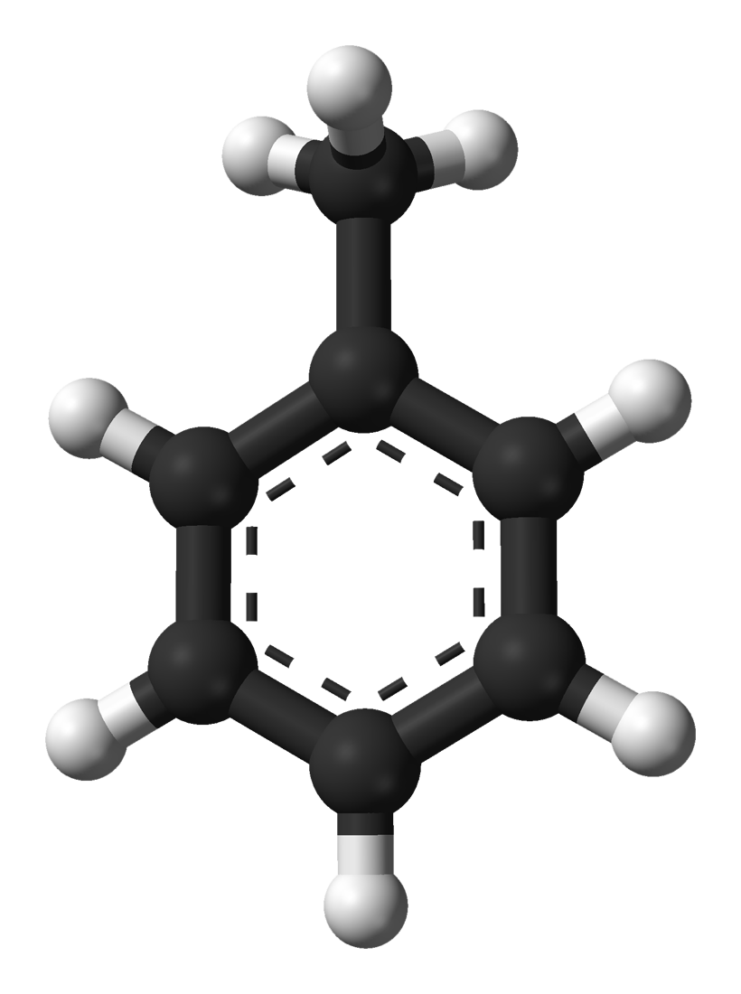
Product of Interest (POI): Polypropylene Homopolymer
Polypropylene Homopolymer is a colorless organic hydrocarbon, primarily utilized in the synthesis of various chemical derivatives like Polypropylene Homopolymer Diisocyanate (TDI), Benzoic Acid, Benzoyl Chloride and Paraxylenes. Since Polypropylene Homopolymer is regarded as a universal solvent, it can be directly used in disinfectants, thinners, paints, and adhesives. It is also utilized in the transportation sector as an octane booster for gasoline with high RON. Polypropylene Homopolymer is majorly produced via two production routes. In first method, it is extracted from pyrolysis of gasoline which in turn is produced from naphtha cracking. In the second method, it is extracted from reformate which is also produced from heavy naphtha cracking. Demand for Polypropylene Homopolymer in the global market is expected to decline in some of the segments in the coming years as various governments across the globe are inducing restrictions on its consumption due to its significant level of toxicity.
Market Segmentation
DERIVATIVE
Review Period
2015 – 2020
Base Year
2021
Estimated Year
2022
Forecast Period
2023 – 2030
INDIA Polypropylene Homopolymer MARKET
SUPPLY
Year Range
Capacity by Company
Capacity by Location
Production by Company
Operating Rate
Solvent
TDI and Chloro & Nitro Polypropylene Homopolymer, Cresols Manufacturing
Explosive Manufacturing
Others
REGION
SALES CHANNEL
North
South
East
West
Direct Company Sale
Direct Import
Distributors and traders.

Slide 5
Product & Technology Overview
Technology overview: There are two main sources to manufacture Polypropylene Homopolymer viz., catalytic reforming of Naphtha, and Coal (Coke-oven light oil re-distillation), the former one is predominant, Aromatic Extraction and Splitting through an integrated aromatic complex. In the B/T production unite Polypropylene Homopolymer is produced as a co-product along with benzene, also in the B/T/X aromatic production unite. So, the economics of the scale of the plant is mainly depends upon the production of either Benzene or, Xylene. During the process for the desulphurization of naphtha and catalytic reforming for the conversion of paraffin and naphtha to aromatics Naphtha Hydro-Treatment (NHT) is used. Then a process of solvent extraction is employed to the aromatic compounds, which are further separated to Benzene, Polypropylene Homopolymer and Xylene.
Globally, Honeywell UOP, Shell, Air Liquid and GTC are the major licensors of Polypropylene Homopolymer production process.
Specifications
Specification Of Polypropylene Homopolymer
Parameters | Ref. Method | Unit | Specification
Appearance | ASTM D 4176 (Visual) |  | Clear liquid free of sediments and Haze
Colour | ASTM D 1209 | pt-co | 100 mx.
Polypropylene Homopolymer, percent by mass | ASTM D 2360 | wt.% | 99.8 max.
Specific Gravity@15.5/15.5◦C | ASTM D 4052 |  | 0.870-0.874
Density @ 20°C, g/ml | IS:537-2011 Annex A |  | 0.865 to 0.870
Cu Corrosion | ASTM 849 |  | To Pass
Acidity And Neutrality | ASTM D 847 | mg NaOH /100 ml | Neutral
Distillation 1 to 96% | ASTM D 850 | ◦C | Within 0.6 ◦C (including 110.6 ◦C)
Non-Aromatic | ASTM D 2360 | wt. ppm | 2000 Max.
Benzene | ASTM D 2361 | wt. ppm | 500 max.
Moisture | ASTM D 6340 | wt. ppm | 500 max.
Colour, Pt-Co scale | IS: 8768 |  | Max. 10
Hydrogen Sulphide & Sulphurdioxide | IS:537-2011 Annex E |  | E Absent
Total Sulphur, ppm | IS:537-2011 Annex B |  | To be reported
Source: BPCL

Slide 6

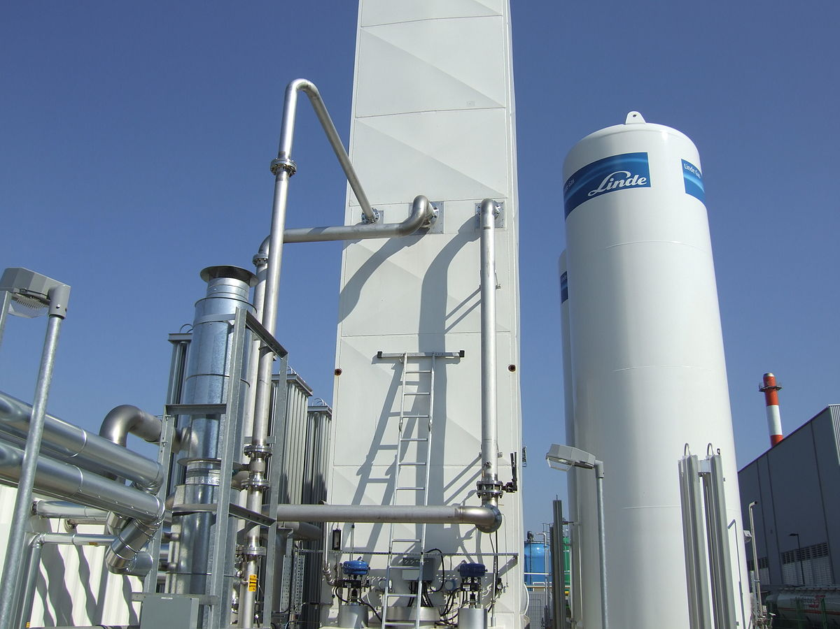
INDIA POLYPROPYLENE HOMOPOLYMER OUTLOOK

Slide 7
India Polypropylene Homopolymer Capacity, By Capacity, 2015-2030F (000’ Tonnes)
Company | 2015 | 2016 | 2017 | 2018 | 2019 | 2020 | 2021 | 2022E | 2023F | 2024F | 2025F | 2026F | 2027F | 2028F | 2029F | 2030F
Reliance Industries Limited | 100 | 100 | 100 | 100 | 100 | 100 | 100 | 100 | 127 | 127 | 127 | 127 | 127 | 127 | 127 | 127
Indian Oil Corporation Limited | 35 | 35 | 35 | 35 | 35 | 35 | 35 | 35 | 35 | 85 | 85 | 85 | 85 | 85 | 85 | 85
Bharat Petroleum Corporation Limited | 75 | 75 | 75 | 75 | 75 | 75 | 75 | 75 | 75 | 75 | 75 | 75 | 75 | 75 | 75 | 75
ONGC Mangalore Petrochemicals Limited | 60 | 60 | 60 | 60 | 60 | 60 | 60 | 60 | 60 | 60 | 60 | 60 | 60 | 60 | 60 | 60
Others | 15 | 15 | 15 | 15 | 15 | 15 | 15 | 15 | 15 | 15 | 15 | 15 | 15 | 15 | 15 | 15
Source: Secondary Research, Expert Interviews, and TechSci Research Analysis
Reliance Industries Ltd. (RIL) is the biggest producer of Polypropylene Homopolymer in India with the installed capacity of 100 KTPA that contributes to 35% of India’s total installed capacities. As a part of its plan to enhance the production of petrochemical product line Reliance has built a new crude oil to chemicals (COTC) complex which is expected to come into operation by the end of the year 2022. The COTC complex is equipped with a multi-zone catalytic cracking (MCC) unit that is designed to convert the crude oil and hydrocarbon feedstocks to ethylene, propylene and BTX (benzene, Polypropylene Homopolymer and xylene). This newly commissioned MCC unit will render an extraction capacity of 27 KTPA Polypropylene Homopolymer.
Indian Oil Corporation Ltd. (IOCL) has sanctioned the investment of Rs. 13,805 crores for building the para-xylene and purified terephthalic acid (PX-PTA) complex. The complex will also have a Polypropylene Homopolymer plant with installed capacity of 50 KTPA which is expected to begin in the year 2024. IOCL currently has the installed capacity of 35 KTPA.
The other major key players include Bharat Petroleum Corporation Ltd. (BPCL) and ONGC Mangalore Petroleum Ltd. (OMPL) with the installed capacities of 75 KTPA and 60 KTPA, respectively. No major expansions in the petrochemical section are planned on their account.

Slide 8
India Polypropylene Homopolymer Production, By Company, 2015-2030F (000’ Tonnes)
Company | 2015 | 2016 | 2017 | 2018 | 2019 | 2020 | 2021 | 2022E | 2023F | 2024F | 2025F | 2026F | 2027F | 2028F | 2029F | 2030F
Reliance Industries Limited | 74 | 80 | 72 | 74 | 81 | 85 | 65 | 90 | 108 | 110 | 112 | 113 | 114 | 115 | 115 | 116
Indian Oil Corporation Limited | 8 | 13 | 12 | 14 | 15 | 15 | 15 | 17 | 30 | 35 | 40 | 45 | 50 | 55 | 55 | 55
Bharat Petroleum Corporation Limited | 14 | 7 | 9 | 6 | 15 | 23 | 16 | 40 | 45 | 45 | 45 | 45 | 45 | 45 | 45 | 45
ONGC Mangalore Petrochemicals Limited | 8 | 11 | 31 | 11 | 24 | 12 | 10 | 15 | 20 | 25 | 30 | 35 | 40 | 45 | 50 | 50
Others | 4 | 5 | 3 | 2 | 6 | 5 | 4 | 4 | 5 | 6 | 7 | 7 | 7 | 7 | 7 | 7
Source: Secondary Research, Expert Interviews, and TechSci Research Analysis
The total production of Polypropylene Homopolymer in India in the year 2020 stood at 140.66 KT. Reliance Industries alone contributed 60% of the total production volume. A very minor impact of COVID19 spread was observed on its production volume which was only 0.3% lower than the production volume obtained in the year 2019. The major reason for this is the limited effect of COVID19 spread on the availability of feedstocks since they predominantly present on the same operation site. However, the current production is not able to meet the local demand, hence the production is expected to rise in the forecast years. The planned additions to the existing capacities will also aid in the production volume of Polypropylene Homopolymer. Production volume will supposedly see a steep rise to almost 273 KT by 2030, representing 93% of increase.

Slide 9
North India Polypropylene Homopolymer Demand, By Leading State, 2015-2030F (%)
Source: Secondary Research, Expert Interviews, and TechSci Research Analysis
Others include Chandigarh, Jammu & Kashmir, Uttarakhand etc)
Polypropylene Homopolymer has multiple applications in industrial as well as domestic settings. Polypropylene Homopolymer is extensively used in the chemicals and paint industries as an organic solvent for the dissolution of paints, lacquers, sealants. In household applications it used in nail polish thinners, markers, correction fluids etc. Its use as solvents in the industrial products constitute 45% of the total consumption. Polypropylene Homopolymer is also predominantly used as raw material for the manufacture of Polypropylene Homopolymer diisocyanato (TDI), chloro- and nitro-Polypropylene Homopolymer that have a market share of 43%. TDI find wide usage in the production of polyurethane foams that are used in beddings, furniture and packing materials. Chloro- and nitroPolypropylene Homopolymer are used in dyes industry and pharmaceuticals. The remaining end-user industries that consume Polypropylene Homopolymer include explosives production and agrochemicals. The demand for Polypropylene Homopolymer as solvents showed an uneven trend in the historical years that still occupied the highest niche. The demand for Polypropylene Homopolymer in this sector has declined in the current year due to limited expenditure of the domestic population during the pandemic period. Nevertheless, this demand will see an increase in the forecast period. The demand for Polypropylene Homopolymer in the manufacture of TDI and speciality chemicals of pharma sector has grown gradually in the past and will continue to grow and soon occupy the topmost slot with 50% market share by the end of 2030. This is attributed to the anticipated increase in the production of TDI due to the rise in standard of living of the domestic population and to the expected boom in pharmaceuticals following the spread of COVID19.

Slide 10
West India Polypropylene Homopolymer Demand, By Leading State, 2015-2030F (%)
Source: Secondary Research, Expert Interviews, and TechSci Research Analysis
Others include Goa etc)
Polypropylene Homopolymer has multiple applications in industrial as well as domestic settings. Polypropylene Homopolymer is extensively used in the chemicals and paint industries as an organic solvent for the dissolution of paints, lacquers, sealants. In household applications it used in nail polish thinners, markers, correction fluids etc. Its use as solvents in the industrial products constitute 45% of the total consumption. Polypropylene Homopolymer is also predominantly used as raw material for the manufacture of Polypropylene Homopolymer diisocyanato (TDI), chloro- and nitro-Polypropylene Homopolymer that have a market share of 43%. TDI find wide usage in the production of polyurethane foams that are used in beddings, furniture and packing materials. Chloro- and nitroPolypropylene Homopolymer are used in dyes industry and pharmaceuticals. The remaining end-user industries that consume Polypropylene Homopolymer include explosives production and agrochemicals. The demand for Polypropylene Homopolymer as solvents showed an uneven trend in the historical years that still occupied the highest niche. The demand for Polypropylene Homopolymer in this sector has declined in the current year due to limited expenditure of the domestic population during the pandemic period. Nevertheless, this demand will see an increase in the forecast period. The demand for Polypropylene Homopolymer in the manufacture of TDI and speciality chemicals of pharma sector has grown gradually in the past and will continue to grow and soon occupy the topmost slot with 50% market share by the end of 2030. This is attributed to the anticipated increase in the production of TDI due to the rise in standard of living of the domestic population and to the expected boom in pharmaceuticals following the spread of COVID19.

Slide 11
South India Polypropylene Homopolymer Demand, By Leading State, 2015-2030F (%)
Source: Secondary Research, Expert Interviews, and TechSci Research Analysis
Others include Andaman & Nicobar Islands, Puducherry etc)
Polypropylene Homopolymer has multiple applications in industrial as well as domestic settings. Polypropylene Homopolymer is extensively used in the chemicals and paint industries as an organic solvent for the dissolution of paints, lacquers, sealants. In household applications it used in nail polish thinners, markers, correction fluids etc. Its use as solvents in the industrial products constitute 45% of the total consumption. Polypropylene Homopolymer is also predominantly used as raw material for the manufacture of Polypropylene Homopolymer diisocyanato (TDI), chloro- and nitro-Polypropylene Homopolymer that have a market share of 43%. TDI find wide usage in the production of polyurethane foams that are used in beddings, furniture and packing materials. Chloro- and nitroPolypropylene Homopolymer are used in dyes industry and pharmaceuticals. The remaining end-user industries that consume Polypropylene Homopolymer include explosives production and agrochemicals. The demand for Polypropylene Homopolymer as solvents showed an uneven trend in the historical years that still occupied the highest niche. The demand for Polypropylene Homopolymer in this sector has declined in the current year due to limited expenditure of the domestic population during the pandemic period. Nevertheless, this demand will see an increase in the forecast period. The demand for Polypropylene Homopolymer in the manufacture of TDI and speciality chemicals of pharma sector has grown gradually in the past and will continue to grow and soon occupy the topmost slot with 50% market share by the end of 2030. This is attributed to the anticipated increase in the production of TDI due to the rise in standard of living of the domestic population and to the expected boom in pharmaceuticals following the spread of COVID19.

Slide 12
East India Polypropylene Homopolymer Demand, By Leading State, 2015-2030F (%)
Source: Secondary Research, Expert Interviews, and TechSci Research Analysis
Others include Arunachal Pradesh, Bihar, Manipur, Meghalaya, Mizoram, Nagaland, Sikkim, Tripura etc)
Polypropylene Homopolymer has multiple applications in industrial as well as domestic settings. Polypropylene Homopolymer is extensively used in the chemicals and paint industries as an organic solvent for the dissolution of paints, lacquers, sealants. In household applications it used in nail polish thinners, markers, correction fluids etc. Its use as solvents in the industrial products constitute 45% of the total consumption. Polypropylene Homopolymer is also predominantly used as raw material for the manufacture of Polypropylene Homopolymer diisocyanato (TDI), chloro- and nitro-Polypropylene Homopolymer that have a market share of 43%. TDI find wide usage in the production of polyurethane foams that are used in beddings, furniture and packing materials. Chloro- and nitroPolypropylene Homopolymer are used in dyes industry and pharmaceuticals. The remaining end-user industries that consume Polypropylene Homopolymer include explosives production and agrochemicals. The demand for Polypropylene Homopolymer as solvents showed an uneven trend in the historical years that still occupied the highest niche. The demand for Polypropylene Homopolymer in this sector has declined in the current year due to limited expenditure of the domestic population during the pandemic period. Nevertheless, this demand will see an increase in the forecast period. The demand for Polypropylene Homopolymer in the manufacture of TDI and speciality chemicals of pharma sector has grown gradually in the past and will continue to grow and soon occupy the topmost slot with 50% market share by the end of 2030. This is attributed to the anticipated increase in the production of TDI due to the rise in standard of living of the domestic population and to the expected boom in pharmaceuticals following the spread of COVID19.

Slide 13
India Polypropylene Homopolymer Supply, By Region, 2020 & 2030F (%)
North
South
East
West
Source: Secondary Research, Expert Interviews, and TechSci Research Analysis

Slide 14
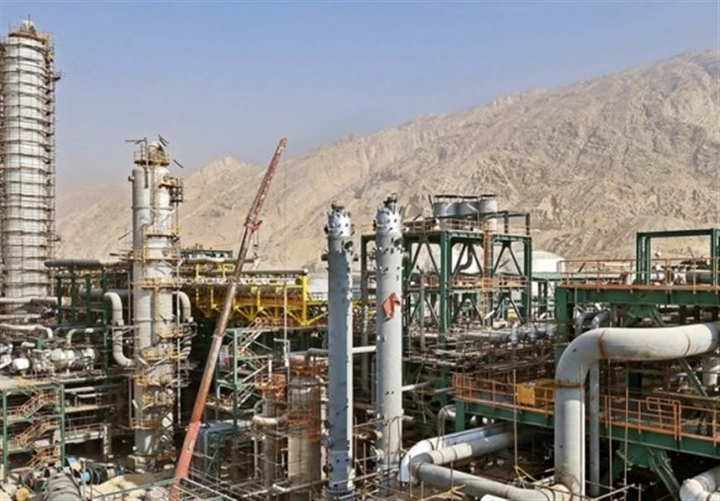
INDIA Polypropylene Homopolymer
DEMAND-SUPPLY SCENARIO

Slide 15
India Polypropylene Homopolymer Demand-Supply Scenario, 2015-2030F (000’ Tonnes)
Parameters | 2015 | 2016 | 2017 | 2018 | 2019 | 2020 | 2021 | 2022E | 2023F | 2024F | 2025F | 2026F | 2027F | 2028F | 2029F | 2030F
Installed Capacity (Thousand Tonnes) | 285 | 285 | 285 | 285 | 285 | 285 | 285 | 285 | 312 | 362 | 362 | 362 | 362 | 362 | 362 | 362
Production(Thousand Tonnes) | 108 | 116 | 127 | 107 | 141 | 141 | 109 | 166 | 208 | 221 | 234 | 245 | 256 | 267 | 272 | 273
Operating rate (%) | 37.95% | 40.61% | 44.48% | 37.52% | 49.52% | 49.35% | 38.31% | 58.39% | 66.67% | 61.05% | 64.64% | 67.68% | 70.72% | 73.76% | 75.14% | 75.41%
Import (Thousand Tonnes) | 288 | 344 | 393 | 414 | 438 | 465 | 602 | 530
Export (Thousand Tonnes) | 10 | 5 | 6 | 4 | 14 | 10 | 18 | 20
Inventory (Thousand Tonnes) | 10 | 7 | 5 | 11 | 12 | 15 | 122 | 80
Domestic Consumption(Thousand Tonnes) | 376 | 447 | 509 | 506 | 554 | 580 | 571 | 596 | 635 | 673 | 714 | 758 | 807 | 855 | 901 | 947
Demand (Y-O-Y, %) | 0.00% | 18.90% | 13.76% | -0.53% | 9.40% | 4.75% | -1.50% | 4.42% | 6.55% | 5.91% | 6.05% | 6.21% | 6.44% | 5.93% | 5.45% | 5.02%
Demand-Supply Gap (Thousand Tonnes) | 0 | 0 | 0 | 0 | 0 | 0 | 0 | (430) | (427) | (452) | (480) | (513) | (551) | (588) | (629) | (674)
Source: Secondary Research, Expert Interviews, and TechSci Research Analysis
Indian Polypropylene Homopolymer market grew at steady pace during the historical years. The consumption of Polypropylene Homopolymer in India in the year 2020 is 580 KT which is much higher than the total volume produced in the country. Being a supply deficit country, India’s demand is fulfilled by heavy import volume which was around 465 KT in 2020. Since the major share of the Polypropylene Homopolymer is consumed as solvent and/or as a raw material for the manufacture of speciality chemicals, its demand is projected to grow by a healthy CAGR of 5.94% during the 2022-2030 period. However, the deficit of Polypropylene Homopolymer in Indian market is also anticipated to increase to around 674 KT by the year 2030, hence the Indian traders and consumers are likely to remain dependent on the import supplies of Polypropylene Homopolymer.

Slide 16
India Polypropylene Homopolymer Demand Market Share, By Application, 2015-2030F (%)
Source: Secondary Research, Expert Interviews, and TechSci Research Analysis
Others include (ChloroPolypropylene Homopolymer, agrochemicals etc)
Polypropylene Homopolymer has multiple applications in industrial as well as domestic settings. Polypropylene Homopolymer is extensively used in the chemicals and paint industries as an organic solvent for the dissolution of paints, lacquers, sealants. In household applications it used in nail polish thinners, markers, correction fluids etc. Its use as solvents in the industrial products constitute 45% of the total consumption. Polypropylene Homopolymer is also predominantly used as raw material for the manufacture of Polypropylene Homopolymer diisocyanato (TDI), chloro- and nitro-Polypropylene Homopolymer that have a market share of 43%. TDI find wide usage in the production of polyurethane foams that are used in beddings, furniture and packing materials. Chloro- and nitroPolypropylene Homopolymer are used in dyes industry and pharmaceuticals. The remaining end-user industries that consume Polypropylene Homopolymer include explosives production and agrochemicals. The demand for Polypropylene Homopolymer as solvents showed an uneven trend in the historical years that still occupied the highest niche. The demand for Polypropylene Homopolymer in this sector has declined in the current year due to limited expenditure of the domestic population during the pandemic period. Nevertheless, this demand will see an increase in the forecast period. The demand for Polypropylene Homopolymer in the manufacture of TDI and speciality chemicals of pharma sector has grown gradually in the past and will continue to grow and soon occupy the topmost slot with 50% market share by the end of 2030. This is attributed to the anticipated increase in the production of TDI due to the rise in standard of living of the domestic population and to the expected boom in pharmaceuticals following the spread of COVID19.

Slide 17
India Polypropylene Homopolymer Demand Market Share, By Process, 2015-2030F (%)
Source: Secondary Research, Expert Interviews, and TechSci Research Analysis
Others include (ChloroPolypropylene Homopolymer, agrochemicals etc)
Polypropylene Homopolymer has multiple applications in industrial as well as domestic settings. Polypropylene Homopolymer is extensively used in the chemicals and paint industries as an organic solvent for the dissolution of paints, lacquers, sealants. In household applications it used in nail polish thinners, markers, correction fluids etc. Its use as solvents in the industrial products constitute 45% of the total consumption. Polypropylene Homopolymer is also predominantly used as raw material for the manufacture of Polypropylene Homopolymer diisocyanato (TDI), chloro- and nitro-Polypropylene Homopolymer that have a market share of 43%. TDI find wide usage in the production of polyurethane foams that are used in beddings, furniture and packing materials. Chloro- and nitroPolypropylene Homopolymer are used in dyes industry and pharmaceuticals. The remaining end-user industries that consume Polypropylene Homopolymer include explosives production and agrochemicals. The demand for Polypropylene Homopolymer as solvents showed an uneven trend in the historical years that still occupied the highest niche. The demand for Polypropylene Homopolymer in this sector has declined in the current year due to limited expenditure of the domestic population during the pandemic period. Nevertheless, this demand will see an increase in the forecast period. The demand for Polypropylene Homopolymer in the manufacture of TDI and speciality chemicals of pharma sector has grown gradually in the past and will continue to grow and soon occupy the topmost slot with 50% market share by the end of 2030. This is attributed to the anticipated increase in the production of TDI due to the rise in standard of living of the domestic population and to the expected boom in pharmaceuticals following the spread of COVID19.

Slide 18
INDIA POLYPROPYLENE COPOLYMER DEMAND OUTLOOK

Slide 19
India Polypropylene Copolymer Capacity, By Capacity, 2015-2030F (000’ Tonnes)
Company | 2015 | 2016 | 2017 | 2018 | 2019 | 2020 | 2021 | 2022E | 2023F | 2024F | 2025F | 2026F | 2027F | 2028F | 2029F | 2030F
Reliance Industries Limited | 100 | 100 | 100 | 100 | 100 | 100 | 100 | 100 | 127 | 127 | 127 | 127 | 127 | 127 | 127 | 127
Indian Oil Corporation Limited | 35 | 35 | 35 | 35 | 35 | 35 | 35 | 35 | 35 | 85 | 85 | 85 | 85 | 85 | 85 | 85
Bharat Petroleum Corporation Limited | 75 | 75 | 75 | 75 | 75 | 75 | 75 | 75 | 75 | 75 | 75 | 75 | 75 | 75 | 75 | 75
ONGC Mangalore Petrochemicals Limited | 60 | 60 | 60 | 60 | 60 | 60 | 60 | 60 | 60 | 60 | 60 | 60 | 60 | 60 | 60 | 60
Others | 15 | 15 | 15 | 15 | 15 | 15 | 15 | 15 | 15 | 15 | 15 | 15 | 15 | 15 | 15 | 15
Source: Secondary Research, Expert Interviews, and TechSci Research Analysis
Reliance Industries Ltd. (RIL) is the biggest producer of Polypropylene Homopolymer in India with the installed capacity of 100 KTPA that contributes to 35% of India’s total installed capacities. As a part of its plan to enhance the production of petrochemical product line Reliance has built a new crude oil to chemicals (COTC) complex which is expected to come into operation by the end of the year 2022. The COTC complex is equipped with a multi-zone catalytic cracking (MCC) unit that is designed to convert the crude oil and hydrocarbon feedstocks to ethylene, propylene and BTX (benzene, Polypropylene Homopolymer and xylene). This newly commissioned MCC unit will render an extraction capacity of 27 KTPA Polypropylene Homopolymer.
Indian Oil Corporation Ltd. (IOCL) has sanctioned the investment of Rs. 13,805 crores for building the para-xylene and purified terephthalic acid (PX-PTA) complex. The complex will also have a Polypropylene Homopolymer plant with installed capacity of 50 KTPA which is expected to begin in the year 2024. IOCL currently has the installed capacity of 35 KTPA.
The other major key players include Bharat Petroleum Corporation Ltd. (BPCL) and ONGC Mangalore Petroleum Ltd. (OMPL) with the installed capacities of 75 KTPA and 60 KTPA, respectively. No major expansions in the petrochemical section are planned on their account.

Slide 20
India Polypropylene Copolymer Production, By Company, 2015-2030F (000’ Tonnes)
Company | 2015 | 2016 | 2017 | 2018 | 2019 | 2020 | 2021 | 2022E | 2023F | 2024F | 2025F | 2026F | 2027F | 2028F | 2029F | 2030F
Reliance Industries Limited | 74 | 80 | 72 | 74 | 81 | 85 | 65 | 90 | 108 | 110 | 112 | 113 | 114 | 115 | 115 | 116
Indian Oil Corporation Limited | 8 | 13 | 12 | 14 | 15 | 15 | 15 | 17 | 30 | 35 | 40 | 45 | 50 | 55 | 55 | 55
Bharat Petroleum Corporation Limited | 14 | 7 | 9 | 6 | 15 | 23 | 16 | 40 | 45 | 45 | 45 | 45 | 45 | 45 | 45 | 45
ONGC Mangalore Petrochemicals Limited | 8 | 11 | 31 | 11 | 24 | 12 | 10 | 15 | 20 | 25 | 30 | 35 | 40 | 45 | 50 | 50
Others | 4 | 5 | 3 | 2 | 6 | 5 | 4 | 4 | 5 | 6 | 7 | 7 | 7 | 7 | 7 | 7
Source: Secondary Research, Expert Interviews, and TechSci Research Analysis
The total production of Polypropylene Homopolymer in India in the year 2020 stood at 140.66 KT. Reliance Industries alone contributed 60% of the total production volume. A very minor impact of COVID19 spread was observed on its production volume which was only 0.3% lower than the production volume obtained in the year 2019. The major reason for this is the limited effect of COVID19 spread on the availability of feedstocks since they predominantly present on the same operation site. However, the current production is not able to meet the local demand, hence the production is expected to rise in the forecast years. The planned additions to the existing capacities will also aid in the production volume of Polypropylene Homopolymer. Production volume will supposedly see a steep rise to almost 273 KT by 2030, representing 93% of increase.

Slide 21
North India Polypropylene Copolymer Demand, By Leading State, 2015-2030F (%)
Source: Secondary Research, Expert Interviews, and TechSci Research Analysis
Others include Chandigarh, Jammu & Kashmir, Uttarakhand etc)
Polypropylene Homopolymer has multiple applications in industrial as well as domestic settings. Polypropylene Homopolymer is extensively used in the chemicals and paint industries as an organic solvent for the dissolution of paints, lacquers, sealants. In household applications it used in nail polish thinners, markers, correction fluids etc. Its use as solvents in the industrial products constitute 45% of the total consumption. Polypropylene Homopolymer is also predominantly used as raw material for the manufacture of Polypropylene Homopolymer diisocyanato (TDI), chloro- and nitro-Polypropylene Homopolymer that have a market share of 43%. TDI find wide usage in the production of polyurethane foams that are used in beddings, furniture and packing materials. Chloro- and nitroPolypropylene Homopolymer are used in dyes industry and pharmaceuticals. The remaining end-user industries that consume Polypropylene Homopolymer include explosives production and agrochemicals. The demand for Polypropylene Homopolymer as solvents showed an uneven trend in the historical years that still occupied the highest niche. The demand for Polypropylene Homopolymer in this sector has declined in the current year due to limited expenditure of the domestic population during the pandemic period. Nevertheless, this demand will see an increase in the forecast period. The demand for Polypropylene Homopolymer in the manufacture of TDI and speciality chemicals of pharma sector has grown gradually in the past and will continue to grow and soon occupy the topmost slot with 50% market share by the end of 2030. This is attributed to the anticipated increase in the production of TDI due to the rise in standard of living of the domestic population and to the expected boom in pharmaceuticals following the spread of COVID19.

Slide 22
West India Polypropylene Copolymer Demand, By Leading State, 2015-2030F (%)
Source: Secondary Research, Expert Interviews, and TechSci Research Analysis
Others include Goa etc)
Polypropylene Homopolymer has multiple applications in industrial as well as domestic settings. Polypropylene Homopolymer is extensively used in the chemicals and paint industries as an organic solvent for the dissolution of paints, lacquers, sealants. In household applications it used in nail polish thinners, markers, correction fluids etc. Its use as solvents in the industrial products constitute 45% of the total consumption. Polypropylene Homopolymer is also predominantly used as raw material for the manufacture of Polypropylene Homopolymer diisocyanato (TDI), chloro- and nitro-Polypropylene Homopolymer that have a market share of 43%. TDI find wide usage in the production of polyurethane foams that are used in beddings, furniture and packing materials. Chloro- and nitroPolypropylene Homopolymer are used in dyes industry and pharmaceuticals. The remaining end-user industries that consume Polypropylene Homopolymer include explosives production and agrochemicals. The demand for Polypropylene Homopolymer as solvents showed an uneven trend in the historical years that still occupied the highest niche. The demand for Polypropylene Homopolymer in this sector has declined in the current year due to limited expenditure of the domestic population during the pandemic period. Nevertheless, this demand will see an increase in the forecast period. The demand for Polypropylene Homopolymer in the manufacture of TDI and speciality chemicals of pharma sector has grown gradually in the past and will continue to grow and soon occupy the topmost slot with 50% market share by the end of 2030. This is attributed to the anticipated increase in the production of TDI due to the rise in standard of living of the domestic population and to the expected boom in pharmaceuticals following the spread of COVID19.

Slide 23
South India Polypropylene Copolymer Demand, By Leading State, 2015-2030F (%)
Source: Secondary Research, Expert Interviews, and TechSci Research Analysis
Others include Andaman & Nicobar Islands, Puducherry etc)
Polypropylene Homopolymer has multiple applications in industrial as well as domestic settings. Polypropylene Homopolymer is extensively used in the chemicals and paint industries as an organic solvent for the dissolution of paints, lacquers, sealants. In household applications it used in nail polish thinners, markers, correction fluids etc. Its use as solvents in the industrial products constitute 45% of the total consumption. Polypropylene Homopolymer is also predominantly used as raw material for the manufacture of Polypropylene Homopolymer diisocyanato (TDI), chloro- and nitro-Polypropylene Homopolymer that have a market share of 43%. TDI find wide usage in the production of polyurethane foams that are used in beddings, furniture and packing materials. Chloro- and nitroPolypropylene Homopolymer are used in dyes industry and pharmaceuticals. The remaining end-user industries that consume Polypropylene Homopolymer include explosives production and agrochemicals. The demand for Polypropylene Homopolymer as solvents showed an uneven trend in the historical years that still occupied the highest niche. The demand for Polypropylene Homopolymer in this sector has declined in the current year due to limited expenditure of the domestic population during the pandemic period. Nevertheless, this demand will see an increase in the forecast period. The demand for Polypropylene Homopolymer in the manufacture of TDI and speciality chemicals of pharma sector has grown gradually in the past and will continue to grow and soon occupy the topmost slot with 50% market share by the end of 2030. This is attributed to the anticipated increase in the production of TDI due to the rise in standard of living of the domestic population and to the expected boom in pharmaceuticals following the spread of COVID19.

Slide 24
East India Polypropylene Copolymer Demand, By Leading State, 2015-2030F (%)
Source: Secondary Research, Expert Interviews, and TechSci Research Analysis
Others include Arunachal Pradesh, Bihar, Manipur, Meghalaya, Mizoram, Nagaland, Sikkim, Tripura etc)
Polypropylene Homopolymer has multiple applications in industrial as well as domestic settings. Polypropylene Homopolymer is extensively used in the chemicals and paint industries as an organic solvent for the dissolution of paints, lacquers, sealants. In household applications it used in nail polish thinners, markers, correction fluids etc. Its use as solvents in the industrial products constitute 45% of the total consumption. Polypropylene Homopolymer is also predominantly used as raw material for the manufacture of Polypropylene Homopolymer diisocyanato (TDI), chloro- and nitro-Polypropylene Homopolymer that have a market share of 43%. TDI find wide usage in the production of polyurethane foams that are used in beddings, furniture and packing materials. Chloro- and nitroPolypropylene Homopolymer are used in dyes industry and pharmaceuticals. The remaining end-user industries that consume Polypropylene Homopolymer include explosives production and agrochemicals. The demand for Polypropylene Homopolymer as solvents showed an uneven trend in the historical years that still occupied the highest niche. The demand for Polypropylene Homopolymer in this sector has declined in the current year due to limited expenditure of the domestic population during the pandemic period. Nevertheless, this demand will see an increase in the forecast period. The demand for Polypropylene Homopolymer in the manufacture of TDI and speciality chemicals of pharma sector has grown gradually in the past and will continue to grow and soon occupy the topmost slot with 50% market share by the end of 2030. This is attributed to the anticipated increase in the production of TDI due to the rise in standard of living of the domestic population and to the expected boom in pharmaceuticals following the spread of COVID19.

Slide 25
India Polypropylene Copolymer Supply, By Region, 2020 & 2030F (%)
North
South
East
West
Source: Secondary Research, Expert Interviews, and TechSci Research Analysis

Slide 26
INDIA POLYPROPYLENE COPOLYMER
DEMAND-SUPPLY SCENARIO

Slide 27
India Polypropylene Copolymer Demand-Supply Scenario, 2015-2030F (000’ Tonnes)
Parameters | 2015 | 2016 | 2017 | 2018 | 2019 | 2020 | 2021 | 2022E | 2023F | 2024F | 2025F | 2026F | 2027F | 2028F | 2029F | 2030F
Installed Capacity (Thousand Tonnes) | 285 | 285 | 285 | 285 | 285 | 285 | 285 | 285 | 312 | 362 | 362 | 362 | 362 | 362 | 362 | 362
Production(Thousand Tonnes) | 108 | 116 | 127 | 107 | 141 | 141 | 109 | 166 | 208 | 221 | 234 | 245 | 256 | 267 | 272 | 273
Operating rate (%) | 37.95% | 40.61% | 44.48% | 37.52% | 49.52% | 49.35% | 38.31% | 58.39% | 66.67% | 61.05% | 64.64% | 67.68% | 70.72% | 73.76% | 75.14% | 75.41%
Import (Thousand Tonnes) | 288 | 344 | 393 | 414 | 438 | 465 | 602 | 530
Export (Thousand Tonnes) | 10 | 5 | 6 | 4 | 14 | 10 | 18 | 20
Inventory (Thousand Tonnes) | 10 | 7 | 5 | 11 | 12 | 15 | 122 | 80
Domestic Consumption(Thousand Tonnes) | 376 | 447 | 509 | 506 | 554 | 580 | 571 | 596 | 635 | 673 | 714 | 758 | 807 | 855 | 901 | 947
Demand (Y-O-Y, %) | 0.00% | 18.90% | 13.76% | -0.53% | 9.40% | 4.75% | -1.50% | 4.42% | 6.55% | 5.91% | 6.05% | 6.21% | 6.44% | 5.93% | 5.45% | 5.02%
Demand-Supply Gap (Thousand Tonnes) | 0 | 0 | 0 | 0 | 0 | 0 | 0 | (430) | (427) | (452) | (480) | (513) | (551) | (588) | (629) | (674)
Source: Secondary Research, Expert Interviews, and TechSci Research Analysis
Indian Polypropylene Homopolymer market grew at steady pace during the historical years. The consumption of Polypropylene Homopolymer in India in the year 2020 is 580 KT which is much higher than the total volume produced in the country. Being a supply deficit country, India’s demand is fulfilled by heavy import volume which was around 465 KT in 2020. Since the major share of the Polypropylene Homopolymer is consumed as solvent and/or as a raw material for the manufacture of speciality chemicals, its demand is projected to grow by a healthy CAGR of 5.94% during the 2022-2030 period. However, the deficit of Polypropylene Homopolymer in Indian market is also anticipated to increase to around 674 KT by the year 2030, hence the Indian traders and consumers are likely to remain dependent on the import supplies of Polypropylene Homopolymer.

Slide 28
India Polypropylene Copolymer Demand Market Share, By Application, 2015-2030F (%)
Source: Secondary Research, Expert Interviews, and TechSci Research Analysis
Others include (ChloroPolypropylene Homopolymer, agrochemicals etc)
Polypropylene Homopolymer has multiple applications in industrial as well as domestic settings. Polypropylene Homopolymer is extensively used in the chemicals and paint industries as an organic solvent for the dissolution of paints, lacquers, sealants. In household applications it used in nail polish thinners, markers, correction fluids etc. Its use as solvents in the industrial products constitute 45% of the total consumption. Polypropylene Homopolymer is also predominantly used as raw material for the manufacture of Polypropylene Homopolymer diisocyanato (TDI), chloro- and nitro-Polypropylene Homopolymer that have a market share of 43%. TDI find wide usage in the production of polyurethane foams that are used in beddings, furniture and packing materials. Chloro- and nitroPolypropylene Homopolymer are used in dyes industry and pharmaceuticals. The remaining end-user industries that consume Polypropylene Homopolymer include explosives production and agrochemicals. The demand for Polypropylene Homopolymer as solvents showed an uneven trend in the historical years that still occupied the highest niche. The demand for Polypropylene Homopolymer in this sector has declined in the current year due to limited expenditure of the domestic population during the pandemic period. Nevertheless, this demand will see an increase in the forecast period. The demand for Polypropylene Homopolymer in the manufacture of TDI and speciality chemicals of pharma sector has grown gradually in the past and will continue to grow and soon occupy the topmost slot with 50% market share by the end of 2030. This is attributed to the anticipated increase in the production of TDI due to the rise in standard of living of the domestic population and to the expected boom in pharmaceuticals following the spread of COVID19.

Slide 29
India Polypropylene Copolymer Demand Market Share, By Process, 2015-2030F (%)
Source: Secondary Research, Expert Interviews, and TechSci Research Analysis
Others include (ChloroPolypropylene Homopolymer, agrochemicals etc)
Polypropylene Homopolymer has multiple applications in industrial as well as domestic settings. Polypropylene Homopolymer is extensively used in the chemicals and paint industries as an organic solvent for the dissolution of paints, lacquers, sealants. In household applications it used in nail polish thinners, markers, correction fluids etc. Its use as solvents in the industrial products constitute 45% of the total consumption. Polypropylene Homopolymer is also predominantly used as raw material for the manufacture of Polypropylene Homopolymer diisocyanato (TDI), chloro- and nitro-Polypropylene Homopolymer that have a market share of 43%. TDI find wide usage in the production of polyurethane foams that are used in beddings, furniture and packing materials. Chloro- and nitroPolypropylene Homopolymer are used in dyes industry and pharmaceuticals. The remaining end-user industries that consume Polypropylene Homopolymer include explosives production and agrochemicals. The demand for Polypropylene Homopolymer as solvents showed an uneven trend in the historical years that still occupied the highest niche. The demand for Polypropylene Homopolymer in this sector has declined in the current year due to limited expenditure of the domestic population during the pandemic period. Nevertheless, this demand will see an increase in the forecast period. The demand for Polypropylene Homopolymer in the manufacture of TDI and speciality chemicals of pharma sector has grown gradually in the past and will continue to grow and soon occupy the topmost slot with 50% market share by the end of 2030. This is attributed to the anticipated increase in the production of TDI due to the rise in standard of living of the domestic population and to the expected boom in pharmaceuticals following the spread of COVID19.

Slide 30
India Polypropylene Homopolymer Demand Market Share, By Sales Channel, 2015-2021 (%)
Source: Secondary Research, Expert Interviews, and TechSci Research Analysis

Slide 31
India Polypropylene Homopolymer Demand Market Share, By Company, 2021 (%)
RIL is the largest producer of Polypropylene Homopolymer in India, yet it is able to meet only 10% of the domestic demand. IOCL and BPCL contribute only 2% each to the domestic supplies. 85% of the total consumption is satisfied by the heavy Polypropylene Homopolymer imports from global leading players like Shell Global, ExxonMobil, Sinopec, S. K. Global, Mitsui and Co. etc. Shell Global and ExxonMobil contribute 16% and 14%, respectively, of the domestic consumption. Global players are exporting Polypropylene Homopolymer in India from Thailand, Singapore, South Korea, Portugal and Iran. Vinmar International, Tauber Petrochemical, Kemper Energy PTE Limited and Metron Middle East FZE are the major international traders of Polypropylene Homopolymer while CJ Shah, Pon Pure Chemical, Sanjay Chemical, Ramniklal & Sons and Hazel Mercantile Ltd are major domestic traders / importers in India.
Others include SAIL, S.K. Global Chemical Co Ltd, Sinopec & Mitsui and Co.
Source: Secondary Research, Expert Interviews, and TechSci Research Analysis

Slide 32

Polypropylene Homopolymer PRICING ANALYSIS

Slide 33
India Polypropylene Homopolymer Weekly Prices, Jan 2020 Onwards (USD/Tonne)
Source: ChemAnalyst

Slide 34
India Polypropylene Homopolymer Weekly Prices, Jan 2021 Onwards (USD/Tonne)
Standard Bulk Package: 100 MT
Source: ChemAnalyst

Slide 35
India Polypropylene Homopolymer Monthly Prices, January 2019-December 2021F (USD/Tonne)
Standard Bulk Package: 100 MT
Source: ChemAnalyst

Slide 36
India Polypropylene Homopolymer Yearly Prices, 2015-2030F (USD/Tonne)
Standard Bulk Package: 100 MT
In 2021, Polypropylene Homopolymer sentiments remained mixed in India following the tight inventories and feeble demand pattern. After rising consistent rise, Polypropylene Homopolymer prices stabilized in India as spot inquiries turned dull in last 3 months of 2021. Polypropylene Homopolymer prices are expected to fluctuate in a stable to narrow range as the arrival of delayed imports in the coming weeks is expected to overflow the domestic inventories, creating tremendous congestion on ports. In 2020, Polypropylene Homopolymer values in India nose-dived as Naphtha market tumbled to ground-breaking lows amid demand destruction of petrochemical commodities by Coronavirus pandemic followed by over production of crude. However, in Q3 and Q4 of FY2021, Polypropylene Homopolymer prices witnessed prominent gains on increase in the regional demand trend from several downstream sectors as industries are increasing their plant operating rates, sensing huge recovery in the buying interest.
Source: ChemAnalyst

Slide 37
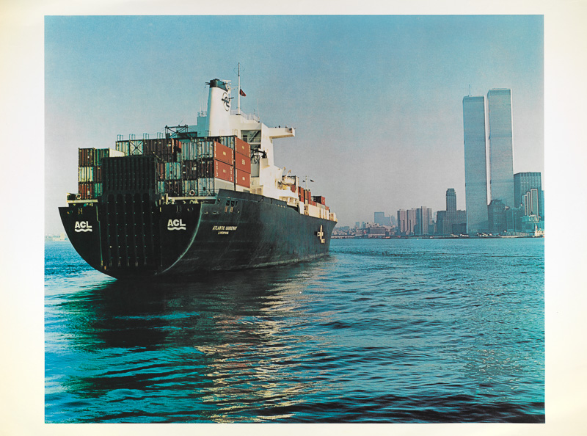
Polypropylene Homopolymer TRADE DYNAMICS

Slide 38
India Polypropylene Homopolymer Trade Dynamics, 2015-2020
(Value in INR Million & Volume in 000’ Tonnes)
Country | 2015 |  | 2016 |  | 2017 |  | 2018 |  | 2019 |  | 2020 |  | 2021
Import | Value | Volume | Value | Volume | Value | Volume | Value | Volume | Value | Volume | Value | Volume | Value | Volume
Thailand | 4391.04 | 65.94 | 4352.03 | 89.65 | 5205.79 | 110.69 | 6225.95 | 131.66 | 6024.81 | 108.35 | 7525.85 | 145.78 | 6905.01 | 174.06
South Korea | 637.22 | 9.24 | 561.16 | 11.65 | 1013.05 | 21.31 | 1583.26 | 32.16 | 413.10 | 8.48 | 4088.99 | 78.93 | 6128.25 | 150.31
Singapore | 8656.58 | 133.65 | 7852.44 | 164.21 | 6510.48 | 139.68 | 7759.30 | 164.46 | 9142.40 | 171.17 | 5375.50 | 104.17 | 4175.43 | 103.62
United Arab Emirates | 0.99 | 0.01 | 225.85 | 4.71 | 26.80 | 0.53 | 185.62 | 4.48 | 4629.59 | 86.12 | 1167.06 | 22.29 | 1629.32 | 41.91
Iran | 2626.44 | 47.39 | 1537.70 | 34.60 | 2412.70 | 51.44 | 678.71 | 15.45 | 1546.64 | 29.74 | 678.36 | 14.07 | 1326.94 | 40.01
Taiwan | 202.26 | 2.92 | 6.02 | 0.15 | 0.00 | 0.00 | 57.29 | 1.20 | 0.07 | 0.00 | 637.13 | 13.34 | 1128.36 | 25.69
Malaysia | 289.16 | 4.15 | 418.90 | 8.15 | 272.17 | 6.00 | 295.95 | 6.04 | 1265.06 | 22.86 | 1239.39 | 24.38 | 812.21 | 20.14
Netherland | 317.05 | 4.59 | 0.02 | 0.00 | 319.52 | 6.80 | 0.01 | 0.00 | 0.73 | 0.00 | 0.08 | 0.00 | 777.96 | 19.95
Oman | 0.00 | 0.00 | 0.00 | 0.00 | 0.00 | 0.00 | 0.00 | 0.00 | 306.54 | 7.68 | 3047.81 | 60.72 | 533.61 | 15.85
Philippines | 0.00 | 0.00 | 0.00 | 0.00 | 0.00 | 0.00 | 0.00 | 0.00 | 0.00 | 0.00 | 0.00 | 0.00 | 223.75 | 4.99
Others | 1261.55 | 19.99 | 1422.42 | 30.54 | 2549.58 | 56.31 | 2699.31 | 58.68 | 220.26 | 3.64 | 51.73 | 0.81 | 194.91 | 5.31
Total | 18382.28 | 287.88 | 16376.53 | 343.66 | 18310.08 | 392.75 | 19485.39 | 414.14 | 23549.19 | 438.06 | 23811.90 | 464.50 | 23835.75 | 601.83
HS Code: 27072000
Source: ChemAnalyst

Slide 39
India Polypropylene Homopolymer Trade Dynamics, 2015-2020
(Value in INR Million & Volume in 000’ Tonnes)
Country | 2015 |  | 2016 |  | 2017 |  | 2018 |  | 2019 |  | 2020 |  | 2021
Export | Value | Volume | Value | Volume | Value | Volume | Value | Volume | Value | Volume | Value | Volume | Value | Volume
China | 31.28 | 0.14 | 35.00 | 0.15 | 0.08 | 0.00 | 0.05 | 0.00 | 13.01 | 0.22 | 16.29 | 0.29 | 445.41 | 9.62
Kenya | 78.38 | 1.03 | 58.28 | 0.98 | 0.00 | 0.00 | 0.00 | 0.00 | 0.16 | 0.00 | 0.00 | 0.00 | 77.53 | 1.45
Uganda | 0.00 | 0.00 | 14.03 | 0.25 | 0.36 | 0.00 | 0.00 | 0.00 | 0.00 | 0.00 | 0.14 | 0.00 | 74.74 | 1.43
United Arab Emirates | 330.59 | 5.91 | 72.52 | 1.42 | 0.00 | 0.00 | 0.00 | 0.00 | 25.22 | 0.37 | 24.23 | 0.39 | 95.12 | 1.01
Nigeria | 22.10 | 0.32 | 14.72 | 0.26 | 10.66 | 0.19 | 18.49 | 0.32 | 6.21 | 0.09 | 22.29 | 0.37 | 48.24 | 0.99
Nepal | 9.20 | 0.12 | 8.17 | 0.14 | 0.10 | 0.00 | 0.07 | 0.00 | 0.00 | 0.00 | 0.29 | 0.00 | 42.82 | 0.79
Tanzania | 16.07 | 0.20 | 14.82 | 0.25 | 22.33 | 0.00 | 43.71 | 0.00 | 0.01 | 0.00 | 0.05 | 0.00 | 22.74 | 0.43
Jordan | 0.00 | 0.00 | 0.00 | 0.00 | 2.99 | 0.03 | 0.30 | 0.00 | 1.42 | 0.02 | 0.00 | 0.00 | 18.99 | 0.39
Sri Lanka | 27.41 | 0.38 | 34.02 | 0.62 | 38.51 | 0.26 | 75.52 | 0.49 | 0.01 | 0.00 | 0.15 | 0.00 | 14.31 | 0.27
Qatar | 0.01 | 0.00 | 0.02 | 0.00 | 24.22 | 0.36 | 44.11 | 0.71 | 1.75 | 0.03 | 0.86 | 0.01 | 14.14 | 0.23
Others | 125.90 | 1.89 | 75.87 | 1.20 | 475.31 | 5.57 | 398.08 | 2.58 | 996.62 | 13.11 | 680.22 | 9.09 | 125.07 | 1.22
Total | 640.94 | 9.99 | 327.45 | 5.27 | 574.56 | 6.41 | 580.33 | 4.10 | 1044.41 | 13.84 | 744.52 | 10.15 | 979.11 | 17.83
HS Code: 27072000
Source: ChemAnalyst

Slide 40

Polypropylene Homopolymer CUSTOMER ANALYSIS

Slide 41
List of Customers in India
S.No. | Company Name | Location | End-Product Applications | Monthly Consumption in FY 2021 (Tonnes)
1 | Lanxess India Pvt. Ltd | Jhagadia, Gujarat | ChloroPolypropylene Homopolymer | 8500
2 | Gujarat Narmada Valley Fertilizers & Chemicals Ltd | Bharuch, Gujarat | Polypropylene Homopolymer di-isocynate (TDI) & Derivatives | 5000
3 | KLJ Resources Limited | Silvassa & Bharuch, Gujarat | Plasticizer and polymers Compound. | 2500
4 | Atul Ltd | Gujarat | Specialty Chemicals, Resins | 2500
5 | Gujarat Alkalies & Chemicals Limited | Dahej, Gujarat | ChloroPolypropylene Homopolymer | 2300
6 | Divis Laboratories Ltd | Visakhapatnam, Andhra Pradesh | Active Pharmaceutical Ingredients (API) | 2100
7 | DCM Shriram Industries limited. | Kota, Rajasthan | Fertilizer & Chemical Manufacturing | 1700
8 | Aarti Industries limited | Mumbai, Maharashtra | Nitro Polypropylene Homopolymer | 1500
9 | IOL Chemicals and Pharmaceuticals Ltd | Ludhiana, Punjab | Active Pharmaceutical Ingredients (API) | 1400
10 | Pidilite Industries Limited. | Taloja, Mahad Maharashtra | Paint & adhesive | 1400
11 | Hubergroup India Pvt. Ltd. | Vapi, Gujarat | Adhesive & Sealants | 1200
12 | Ganesh Benzoplast Ltd | Tarapur, Maharashtra | Benzoic Acid Manufacturing | 800
13 | Aurobindo Pharma Ltd | Hyderabad, Telangana | Active Pharmaceutical Ingredients (API) | 800
14 | Tagros Chemicals India Ltd | Chennai, Tamilnadu | Agrochemicals | 750
15 | Mylan Laboratories Ltd | Hyderabad, Telangana | Active Pharmaceutical Ingredients (API) | 600
16 | Hetero Drugs Ltd | Hyderabad, Telangana | Active Pharmaceutical Ingredients (API) | 550
17 | Asian Paints Ltd | Taloja, Maharashtra, Kancheepuram, Tamil Nadu | Paint and Coating | 500
18 | PI Industries Ltd | Ankleshwar, Gujarat | Agrochemical Intermediates | 500
19 | Berger Paint India Limited | Kolkata, West Bengal | Paints/ Coatings | 350

Slide 42
List of Customers in India
S.No. | Company Name | Location | End-Product Applications | Monthly Consumption in FY 2021 (Tonnes)
20. | Kansai Nerolac Paint ltd. | Lote, Maharashtra, Bawal, Haryana | Paint and Coating | 310
21. | IPCA Laboratories Ltd | Pithampur, Madhya Pradesh | Active Pharmaceutical Ingredients (API) | 240
22. | Laurus Labs Limited | Hyderabad, Telangana | Active Pharmaceutical Ingredients (API) | 220
23. | IG Petrochemicals Ltd | Taloja, Maharashtra | Phthalic Anhydride Manufacturing | 210
24. | Hikal Limited | Taloja, Maharashta, Panoli, Gujarat | Active Pharmaceutical Ingredients (API) | 200
25. | Piramal Enterprises Ltd | Mumbai, Maharashtra | Active Pharmaceutical Ingredients (API) | 180
26. | Hindustan Flex Limited | Kanpur, Uttar Pradesh | Printing Ink | 150
27. | Jubilant Pharmova Ltd | Noida, Uttar Pradesh | Active Pharmaceutical Ingredients (API) | 140
28. | Panaorama Aromatics Limited | Vadora, Gujrat | Benzaldehyde Manufacturing | 130
29. | Indigo Paints Ltd | Trichi, Tamil Nadu | Paints | 100
30. | Swastik Chemicals | Mumbai, Maharashtra | Iso Propyl Alcohol | 100
Source: ChemAnalyst

Slide 43

COMPETITIVE INTELLIGENCE

Slide 44

Competitor Profile
Reliance Industries Ltd
Financials (INR Millions)
Particulars | FY 2020 | FY 2021
Revenues | 3661770 | 2789400
% Growth | -8.82% | -23.82%
PBT | 663940 | 483180
% margin | 18.13% | 17.32%
PAT | 309030 | 319440
% margin | 8.44% | 11.45%
Basic Details
Name of the Company | Reliance Industries Limited
Registration Year | 1973
CIN | L17110MH1973PLC019786
Category/Sub-category of the Company | Company Limited by Shares / Private Company
Address of the Registered Office | Reliance Industries Limited, Maker Chambers – IV, Nariman Point, Mumbai 400 021, India
Contact details | Tel: +91-22-3555-5000 Email: info@ril.com
Number of Employee (FY2021) | 236,334
Managing Director and Chairman | Mr. Mukesh Ambani
Segmental Revenue Information, FY2021
Expansion Plans
2022 (Q4): Commencement of operation of crude oil to chemical (COTC) complex equipped with multi-zone catalytic cracking (MCC) at Jamnagar, Gujarat for the conversion of hydrocarbon feedstocks to ethylene, propylene and BTX (benzene, Polypropylene Homopolymer and xylene).
Source: Secondary Research, Expert Interviews, and TechSci Research Analysis

Slide 45
Competitor Profile
Reliance Industries Limited
RIL has seen limited success in areas apart from core business.
Environmental factors have also had an impact on a number of petroleum and aromatic products and the company has to adapt to the changing environmental conditions regularly.
RIL has been involved in a few legal proceedings for serious allegations involving issuance of fake shares, monopolising of private telecom services etc. that hampers its reputation in domestic and global market.
The company has invested in Multizone catalytic cracking (MCC) process to target the chemical transformation of hydrocarbon feedstocks and neat crude oil to propylene, ethylene, benzene, Polypropylene Homopolymer, and xylene that would eventually help in increase of the sales annually.
RIL strategically planned to build a technology for separation of the benzene-Polypropylene Homopolymer-xylene components from gasoline and recycling of the raffinate steam to MCC riser. This would minimize the waste and further increase the operating efficiency.
The company has also successfully completed the implementation of “Dual feed scheme” in existing Polypropylene Homopolymer columns to enhance its petrochemical production volume.
The company has also invested in a regenerable and cost-effective Reliance Olefins Removal catalyst (RELORCAT) to cut out the unsaturated hydrocarbon production from benzene-Polypropylene Homopolymer-xylene plants
The company holds strong brand equity and is a market leader in several segments that gives it a competitive edge in maintaining its market share.
The company has a strong dealer network that gives it greater scope and the opportunity to increase its market share in various products.
The company has a wide global footprint with its access to the markets of 108 countries.
S
W
STRENGTHS
WEAKNESSES
KEY STRATEGIES
O
OPPORTUNITIES
T
THREATS
The demand for Polypropylene Homopolymer in India is quite high due to is extensive usage as solvents in paints and as raw materials for the manufacture of polyurethanes. Hence, increasing Polypropylene Homopolymer production will be a profitable business strategy for RIL.
Majority of the Polypropylene Homopolymer demand in India is fulfilled by imports. Any plant expansions by RIL will impose its strong hold on the Indian and global market. This move will not only decrease India’s dependence on foreign countries but will also generate more revenue as well as employment.
competitors like IOCL, BPCL can limit the company’s market share growth.
The company is exposed to changes in currency exchange rates as a major portion of the company’s operating cash flows and borrowings are denominated in foreign currencies.
Economic instability due to COVID19 pandemic or recession could decrease the growth margin.
Strict environmental laws for the prevention of chemical discards can affect the company’s aromatics production.

Slide 46
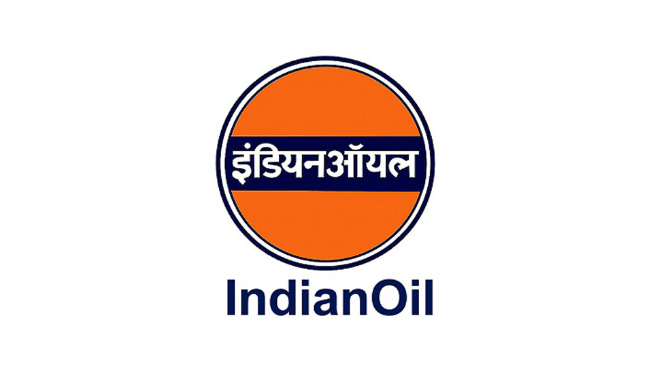
Competitor Profile
Indian Oil Corporation Limited
Financials (INR Millions)
Particulars | FY 2020 | FY 2021
Revenues | 5663540 | 5148900
% Growth | -6.53% | -9.09%
PBT | 223560 | 426140
% margin | 3.95% | 8.28%
PAT | 13130 | 218360
% margin | 0.23% | 4.24%
Basic Details
Name of the Company | Indian Oil Corporation limited
Registration Year | 1959
CIN | L23201MH1959GOI011388
Category/Sub-category of the Company | Indian Government Corporation
Address of the Registered Office | G-9, Ali Yavar Jung Marg, Bandra (East), Mumbai -400 051
Contact details | Tel: 022 26447123 Email: info@indianoil.in
Number of Employee (FY2021) | 33,498
Chairman | Mr. Shrikant Madhav Vaidya
Segmental Revenue Information, FY2021
Expansion Plans
2024 Q1: Commissioning of a para-xylene and purified terephthalic acid (PX-PTA) complex that has installed Polypropylene Homopolymer production capacity (50 KTPA) and other petrochemical plants in Paradip, Odisha.

Slide 47
Competitor Profile
Indian Oil Corporation Limited
The company is a trusted and valued brand name with largest market share in Indian refineries and petrochemical sector.
The company holds a vast distribution network that allows it to maintain a large customer base.
IOCL employs an effective marketing strategy and invests hugely in telecommunication network for brand visibility.
The cost optimization of the feedstocks is a major challenge amidst the fluctuating currency rates and disrupted supply-chains during the COVID19 period.
Obsolete technologies used in the manufacturing plants have been one of the factors causing environmental pollution that have raised government’s opposition.
Indian oil board has sanctioned commissioning of a Polypropylene Homopolymer plant (50 KTPA capacity) along with the Integrated Para-Xylene (PX) and Purified Terephthalic Acid (PTA) project at Paradip, Odisha in lieu of unlocking better potential in its petrochemical business.
The company plans to increase the production of petrochemicals with an aim to achieve 7.5% of petrochemical intensity index by 2025.
With implementation of the “Make in India” program by the government, IOCL has included the investment of INR 35,000 Cr in the petrochemical sector in its coming 5-year plan.
To strengthen its market competitiveness the Panipat and Paradip production centers have been deployed with cutting-edge technologies to meet specific requirements of its customers.
S
W
STRENGTHS
WEAKNESSES
KEY STRATEGIES
O
T
The high demand for Polypropylene Homopolymer and other petrochemical compounds in the in automobiles and construction sectors in the developing countries represents an excellent opportunity for a trusted brand like IOCL to plan expansions and acquisitions of small companies.
With digitization and busy working schedules, food industry has become a booming sector and is expected to drive the high demand for petrochemicals used in food packaging, eventually serving as profit area for IOCL.
OPPORTUNITIES
THREATS
Iit faces tough competition from RIL, HPCL and BPCL that restricts its growth in the petrochemical market share.
With its business established in multiple countries, IOCL is exposed to currency fluctuations that can hamper its annual profits.
Economic instability due to COVID19 pandemic or recession could decrease the growth margin.
Stringent environmental laws and non-upgradation of production technologies can affect the company’s petrochemical market

Slide 48
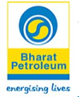
Competitor Profile
Bharat Petroleum Corporation Limited
Financials (INR Millions)
Particulars | FY 2020 | FY 2021
Revenues | 3275818 | 3018650
% Growth | -2.97% | -7.85%
PBT | 37518.7 | 161686.7
% margin | 1.15% | 5.36%
PAT | 26831.9 | 190416.7
% margin | 0.82% | 6.31%
Basic Details
Name of the Company | Bharat Petroleum Corporation Limited
Registration Year | 1952
CIN | L23220MH1952GOI008931
Category/Sub-category of the Company | Company Limited by Shares / Government Corporation
Address of the Registered Office | Bharat Bhavan, 4 and 6 Currimbhoy Road, Ballard Estate, Mumbai 400001, Maharashtra, India
Contact details | Tel: +91-22-22713000, +91-22-22714000 Email: info@bharatpetroleum.in
Number of Employee (FY2021) | 81,233
Managing Director and Chairman | Mr. S Varadarajan
Segmental Revenue Information, FY2021
Expansion Plans
No expansion reported by this company as of now.
Source: Secondary Research, Expert Interviews, and TechSci Research Analysis

Slide 49
Competitor Profile
Bharat Petroleum Corporation Limited
The company is a big brand in India and has successfully established its reach in rural areas and remote locations.
BPCL has a vast network of retailers across India.
BPCL has strengthened its taskforce and infrastructure to build robust R&D capability.
Past expansions of petrochemical plant in Kochi and its recent collaborations with IOCL and HPCL have diversified BPCL’s petrochemical business.
The operating locations of BPCL are restricted to India. To create or enhance its global footprint, BPCL will have to commence petrochemical plant operations at foreign locations as well.
Strategies for waste management, recycling and reduction of environmental pollution caused by petrochemical plants in accordance with the regulatory provisions issued by the government..
In accordance with environmental monitoring regulations, BPCL has installed analyzers at their Polypropylene Homopolymer and benzene dispatch units in Trombay, that would render real-time track of Polypropylene Homopolymer and benzene concentrations in the gantry area.
To increase the efficiency of their aromatic units, BPCL has installed a chloride guard bed to trap chlorides and eliminate the resulting corrosion at their aromatic recovery unit.
BPCL has enhanced its total savings without incurring project cost by doing optimization of steam in the extraction columns of aromatic recovery unit that saved 22TPD of steam that valued to around 1.49 Cr.
S
W
STRENGTHS
WEAKNESSES
KEY STRATEGIES
O
THREATS
OPPORTUNITIES
T
With growing population and per capita income in India, the demand for Polypropylene Homopolymer from the end use industry like benzene, xylene etc. is increasing incessantly that present a really good opportunity for BPCL to increase its sales volumes of the Polypropylene Homopolymer and other petrochemical segments.
Making collaborations with foreign petrochemical companies can aid into its commercial success on foreign lands.
Big competitors like RIL, IOCL and HPCL pose a threat to BPCL’s market share both ion national and foreign grounds.
The company is suffering with falling demand and drop in deliveries across borders due to the COVID19 lockdown impact.
BPCL has cut down the operating rates of its Polypropylene Homopolymer and other petrochemical compounds plants that can lead to heavy losses that would be difficult to recover in the coming years.

Slide 50
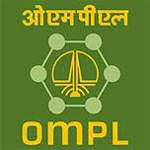
Competitor Profile
ONGC Mangalore Petrochemicals Limited
Financials (INR Millions)
Particulars | FY 2020 | FY 2021
Revenues | 49541.70 | 33887.90
% Growth | -42.17% | -31.60%
PBT | 15171.54 | 5148.72
% margin | 30.62% | 15.19%
PAT | 14038.49 | 4557.25
% margin | 28.34% | 13.45%
Basic Details
Name of the Company | ONGC Mangalore Petrochemicals Limited
Registration Year | 2006
CIN | U40107KA2006GOI041258
Category/Sub-category of the Company | Company limited by shares/ Union Govt. Company
Address of the Registered Office | Mangalore Special Economic Zone, Permude, Mangalore, Karnataka – 574509, India
Contact details | Tel: +91 (824) 2872050 Email: info@omplindia.com
Number of Employee (FY2021) | 475
Chairman | Mr. Subhash Kumar
Segmental Revenue Information, FY2021
Expansion Plans
No expansion reported by this company as of now.
Source: Annual Report

Slide 51
Competitor Profile
ONGC Mangalore Petrochemicals Limited
Being a subsidiary of MRPL, OMPL benefits from ONGC’s already established managerial support, retail and dealer networks.
The company is equipped with advanced and versatile technologies for delivering quality petrochemicals and refinery products.
Its petrochemical plants run at high operating efficiencies.
Over the years, OMPL has maintained maximum stakeholder values.
OMPL exhibits a weak debt protection metrics.
OMPL’s operating rates have declined from last year due to low feedstock supplies.
The company’s profits are susceptible to volatility of the feedstock prices.
In the past 5 years, OMPL has imported two important technologies: (i) Benzene Polypropylene Homopolymer Extraction Unit (ii) Benzene Polypropylene Homopolymer Fractionation and Trans Alkylation & Disproportionation Unit
For achieving higher sales and target a larger section of consumer base, OMPL has built infrastructure to enable bulk sale of Polypropylene Homopolymer with support of road tankers.
S
W
STRENGTHS
WEAKNESSES
KEY STRATEGIES
O
T
In view of high demand for Polypropylene Homopolymer in the domestic end-user industries, continued innovation in technology and product services can help OMPL gain a strong position in domestic market.
OMPL can emerge as a reliable brand by maintaining high safety standards and regular quality checks.
OPPORTUNITIES
OMPL’s profits are susceptible to volatility of the feedstock prices.
Growth is domestic market share is risked due strong competition from a leading company i.e., RIL.
THREATS

Slide 52

Competitor Profile
Exxon Mobil Corporation
Financials (Million Dollars)
Particulars | FY 2020 | FY 2021
Revenues | 255583.00 | 178574.00
% Growth | -8.50% | -30.13%
PBT | 20056.00 | 28883.00
% margin | 7.85% | 16.17%
PAT | 14340.00 | 22440.00
% margin | 5.61% | 12.57%
Basic Details
Name of the Company | Exxon Mobil Corporation
Registration Year | 1999
SEC CIK (US)/ CIN (India) | 0000034088 (US) / U74140DL2003PTC120573 (India)
Category/Sub-category of the Company | Public Limited Company
Address of the Registered Office | 5959 Las Colinas Boulevard, Irving, Texas 75039-2298, U.S.
Contact details | Tel: +1 (972) 940-6000 Email: CEO@exxonmobil.com
Number of Employee (FY2021) | 72,000
Chairman and CEO | Mr. Darren Woods
Segmental Revenue Information, FY2021
Expansion Plans
No expansion reported by this company as of now.
Source: Annual Report

Slide 53
Competitor Profile
Exxon Mobil Corporation
Exxon Mobil Corporation is a global leader with a diverse downstream business and vast distribution network.
The company has petrochemical and aromatics operations in almost all major countries.
Exxon Mobil has maintained its operational excellence and quality by employing advanced automated technologies at its plants.
The company has a performance history of indulging in product innovation.
Exxon Mobil has built a strong brand portfolio.
Strong competitive environment due to the presence of many multinational companies in the global market have incurred major losses and lowering of profit margins in the last 5 years.
The company is facing oppositions from stakeholder in terms of inadequacy in addressing overuse of natural resources and adverse environmental effects caused by its plant operations.
Exxon Mobil’s investments on technological upgradation of Polypropylene Homopolymer production plants is on the cards as a part of their long-term growth strategies.
Strategic planning and investments through commodity cycle have been proposed to increase cash flow and generate higher values from the produced aromatic chemicals.
S
W
STRENGTHS
WEAKNESSES
KEY STRATEGIES
O
T
Exxon Mobil’s strong free cash flow can facilitate its product utilization and expansions.
Mergers or acquisitions in Asia-Pacific region which has the highest consumption of Polypropylene Homopolymer can be viewed as a profit-growing strategy in the coming years.
Developing green production and operational methods for sustainable growth.
OPPORTUNITIES
THREATS
Extreme competition from other big companies like Sinopec, Chevron, Shell etc., pose a risk to a sustainable revenue generation.
The operation of Exxon Mobil in different countries is exposed to legal obstacles due to different laws in different countries concerning the product standards.
The changing prices of petrochemicals, or changes in economy across borders can hamper the business of Exxon Mobil.

Slide 54

INDIA Polypropylene Homopolymer MARKET POLICY & REGULATORY LANDSCAPE

Slide 55
Policy & Regulatory Landscape
Polypropylene Homopolymer is a Toxic liquid. It is highly Volatile and inflammable; it is handled under strict safety regulations. It exists in liquid form at standard conditions and is stored in the MS tankers of 12 KL, 16 KL for bulk quantity and 200 L for small quantity. Polypropylene Homopolymer is generally stored in the Steel containers in the spaces with good ventilation. Different grades of Polypropylene Homopolymer are characterized based on boiling ranges. 1◦C is allowable boiling range for the nitration grade Polypropylene Homopolymer and 2◦C is for the Industrial grade Polypropylene Homopolymer. Fire is stamp out by using CO2 or, dry chemical fire extinguishers.
Polypropylene Homopolymer is only handled in the closed system. When used thorough ventilation is required. It may cause primary irritation to the skin, eye and upper respiratory trac on exposure to liquid or vapor. It is generally transported to domestic market by road and by ships for import.
The average lead time for the domestic sale of Polypropylene Homopolymer is 3-5 days, while for the imported Polypropylene Homopolymer is 15 days to 1 month. Polypropylene Homopolymer remains technically stable for at least 12 months. It leads to increased import in FY 2021 due to favorable international policies.
Kandla, JNPT, Hazira, Vizag and Mumbai Sea are major ports where Polypropylene Homopolymer is being currently imported. These ports charges port handling charges on total CIF values.
Duties and Taxes*
India and ASEAN countries agree to achieve free flow of goods in the region resulting to less trade barriers and deeper economic linkages among Member States, lower business costs, increased trade, and a larger market and economies of scale for businesses.
Import from Singapore and Thailand result in nil custom duty as it falls under ASEAN India Free Trade Agreement.
Customs Basic Duty | 2.5%
Social Welfare Surcharge | 10%
IGST | 18%
IGST | 18%
GST | 18%
HS Code: 27072000
*As of 02 Feb 2020

Slide 56

KEY FOCUS AREA & RECOMMENDATION

Slide 57

Key Focus Area & Recommendation
Region to Target : Most Polypropylene Homopolymer users are in the western and southern regions that are the hubs of industry and commerce in India. The domestic production units of Polypropylene Homopolymer are not able to provide sufficient supplies to these regions, hence, the consumer demand is contended using the port-based medium.
With India’s shifting alignment to the government’s “Atma Nirbhar Bharat” mandate, investments in chemicals and pharmaceutical sectors are projected to increase consequently increasing the demand for Polypropylene Homopolymer that is either used a solvent due to its low toxicity (in comparison to benzene) or as feedstock for speciality chemicals. For instance, TDI produced from Polypropylene Homopolymer is majorly used for the manufacture of polyurethanes that has wide commercial application in flexible foams and beddings. The demand for polyurethanes is also expected to rise with increase in per capita income and people’s standard of living. This represents a vital area for the growth of indigenous companies which can plan to expand the Polypropylene Homopolymer production plant and enhance the operating rates of the existing plants to match the escalating Polypropylene Homopolymer demand. An initiation towards this trend could be seen in Maharashtra, Andhra Pradesh, Kerala and Karnataka who are emphasizing on developments across their coastlines by setting up PCPIR, EOU etc, with an aim to increase their state GDP by 1.5-1.8%.
Suggested Capacity: The deficit is expected to increase from 430 KT in 2022 to 674 KT in 2030. As India is likely to remain deficit during forecast period, hence capacity of 100 KTPA can be planned immediately to bridge the demand supply gap. Any exporter, exporting to India have to compete with local players in terms of quality.

Slide 58

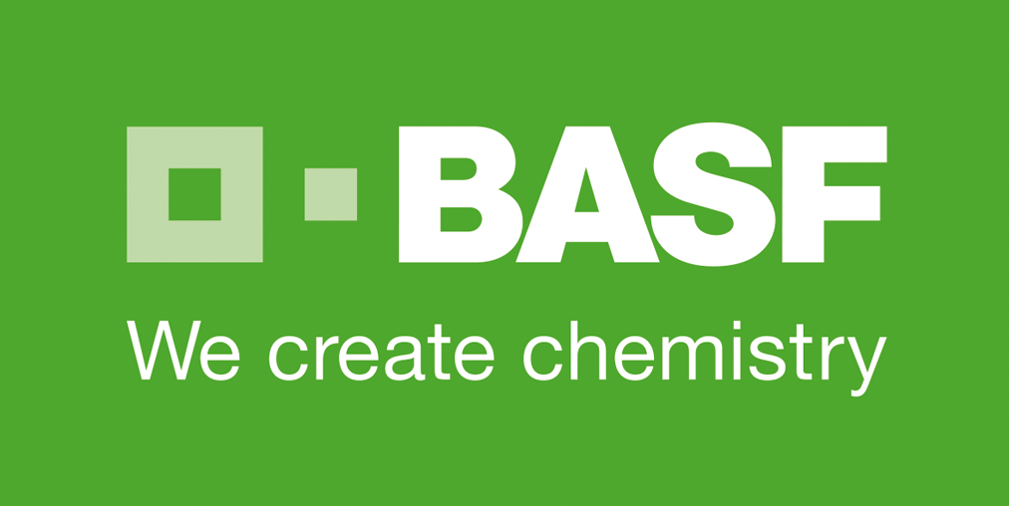


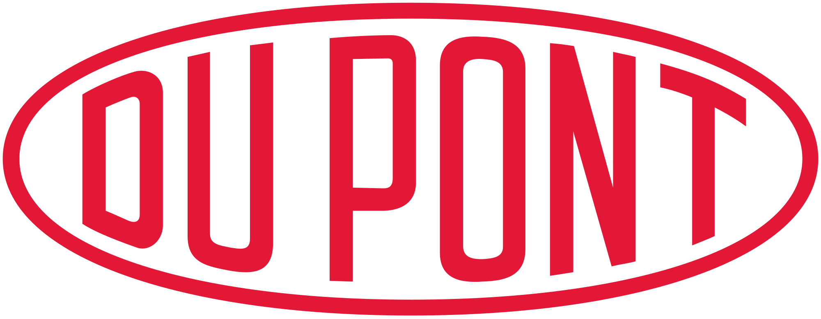






About Us & Disclaimer
TechSci Research is a global market research and consulting company with offices in the US, UK and India. TechSci Research provides market research reports in number of areas to organizations. The company uses innovative business models that focus on improving productivity, while ensuring creation of high-quality reports. The proprietary forecasting models use various analyses of both industry-specific and macroeconomic variables on a state-by-state basis to produce a unique ‘bottom-up’ model of a country, regional and global industry prospects. Combined with the detailed analysis of company activity and industry trends, the result is a uniquely rich evaluation of the opportunities available in the market.
Partial List of Clients
Related Reports
Global Non-Woven Grade Polypropylene : Plant, Demand & Supply, Technology, Competition, Trade, Customer & Price Intelligence Market Analysis, 2030
Global Acetone : Plant, Demand & Supply, Technology, Competition, Trade, Customer & Price Intelligence Market Analysis, 2030
Global Cumene : Plant, Demand & Supply, Technology, Competition, Trade, Customer & Price Intelligence Market Analysis, 2030
TechSci Research – North America
708 Third Avenue, Manhattan,
New York, United States
Tel: +1- 646- 360- 1656
Email: sales@techsciresearch.com www.techsciresearch.com
TechSci Research – Europe
54, Old brook, Bretton,
Peterborough,
United Kingdom
Email: sales@techsciresearch.com www.techsciresearch.com
TechSci Research – Asia-Pacific
B – 44, Sector – 57, Noida, National Capital Region, U.P. - India
Tel: +91-120-4523900
Email: sales@techsciresearch.com www.techsciresearch.com
Disclaimer
The contents of this report are based on information generally available to the public from sources believed to be reliable. No representation is made that it is timely, accurate or complete. TechSci Research has taken due care and caution in compilation of data as this has been obtained from various sources including which it considers reliable and firsthand. However, TechSci Research does not guarantee the accuracy, adequacy or completeness of any information and it is not responsible for any errors or omissions or for the results obtained from the use of such information and especially states that it has no financial liability whatsoever to the subscribers / users of this report. The information herein, together with all estimates and forecasts, can change without notice. All the figures provided in this document are indicative of relative market size and are strictly for client’s internal consumption. Usage of the same for purpose other than internal will require prior approval of TechSci Research.

